Slide 1
BCSE103E- Computer Programming: Java
Pinisetti Akshai Kumar,
Email id – pinisetti.akshai@vit.ac.in
Open hours Tuesday 2:00 PM – 4:30 PM
Thursday 2:00 PM – 3:30 PM
Friday 9:30 AM – 11:30 AM

Slide 2
Contents
Packages
Exceptions

Slide 3
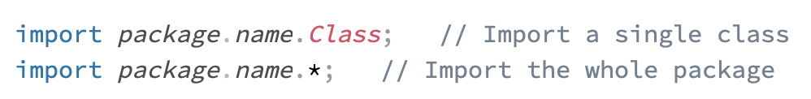

Packages
A package in Java is used to group related classes. (a folder in a file directory)
To avoid name conflicts, and to write a better maintainable code.
Packages are divided into two categories:
Built-in Packages (packages from the Java API)
User-defined Packages (create your own packages)

Slide 4
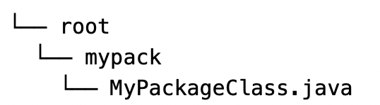
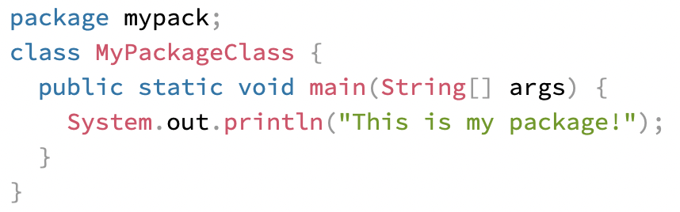
User defined package
Java uses a file system directory to store them. Just like folders on your computer:
To create a package, use the package keyword: MyPackageClass.java *** The package name should be written in lower case to avoid conflict with class names.

Slide 5

Steps
Save the file as MyPackageClass.java, and compile it:
Then compile the package: ** When we compiled the package in the example above, a new folder was created, called "mypack". “-d” - destination for where to save the class file (c:/user) To keep the package within the same directory “.”
To run the MyPackageClass.java file, write the following:
The output will be:

Slide 6
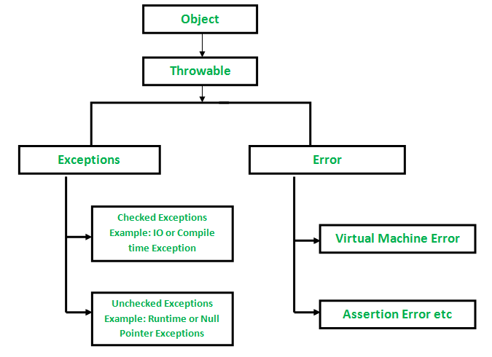

Slide 7
Major reasons why an exception Occurs
Invalid user input
Device failure
Loss of network connection
Physical limitations (out of disk memory)
Code errors
Opening an unavailable file
Errors represent irrecoverable conditions such as Java virtual machine (JVM) running out of memory, memory leaks, stack overflow errors, library incompatibility, infinite recursion, etc. Errors are usually beyond the control of the programmer, and we should not try to handle errors.

Slide 8
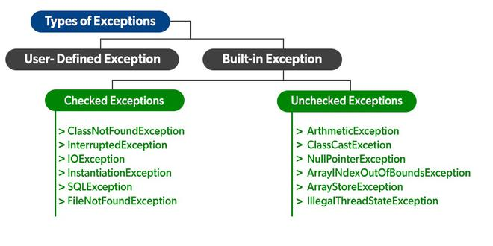
Compile-time Run-time

Slide 9
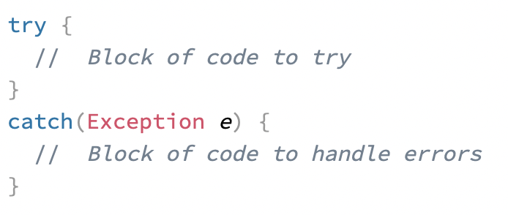
try catch
The try statement allows you to define a block of code to be tested for errors while it is being executed.
The catch statement allows you to define a block of code to be executed, if an error occurs in the try block.

Slide 10
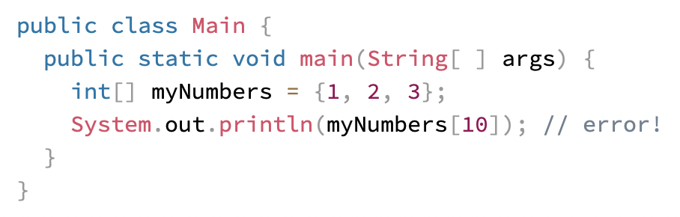
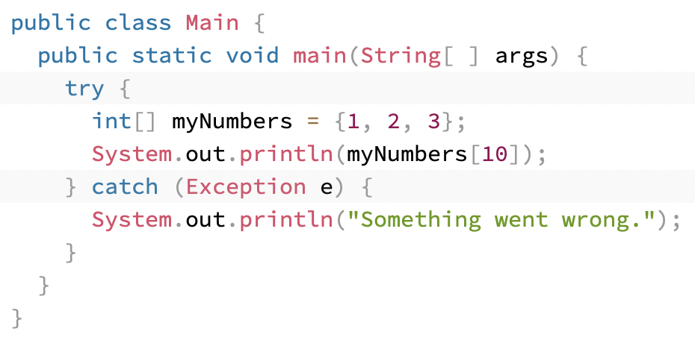

The try and catch keywords come in pairs:

Slide 11
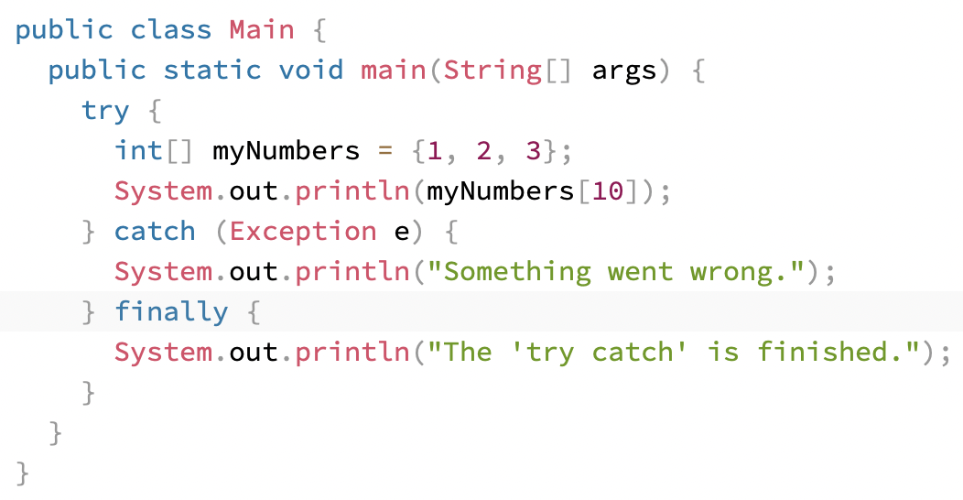
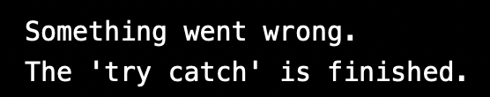
finally
The finally statement lets you execute code, after try...catch, regardless of the result

